Slide 1

Data Science in Healthcare and its pitfalls
Gabriel Campos

Slide 2
Google Flu Trends
2008 | 2009 | 2013 | LegacY
Launched by Google to outperform CDC’s FluView tracker. | First published on February 19 in nature.com’s article Detecting influenza epidemics using search engine query data | Flu outbreak Worst in recent history | Primary example of “BIG DATA HUBRIS”
Combine CDC data and Google web search terms to identify flu outbreak. Datacollaboratives.org | Promised to detect “seasonal” flu at faster rate and pitched the potential to stop potential pandemics, if an evolve strain broke out. Natrue.com | GFT missed Flu peak season by 140% | Request for releasing of holders of big data to the public. Ellaborate on conclusion
Algorithm involved identifying 50 million search terms to fit 1152 data points | Marketed the tracking model as “now casting” | Quiet discontinuation of the tracker

Slide 3

Announce in 2014 by IBM
Combined Watson’s Natural Language Processing (NLP), IBM Cloud, massive databank of unstructured text and metadata, for analytics use.
Promised to improve accuracy of determining patient illness, with unbiased, fact driven diagnosing.

Slide 4
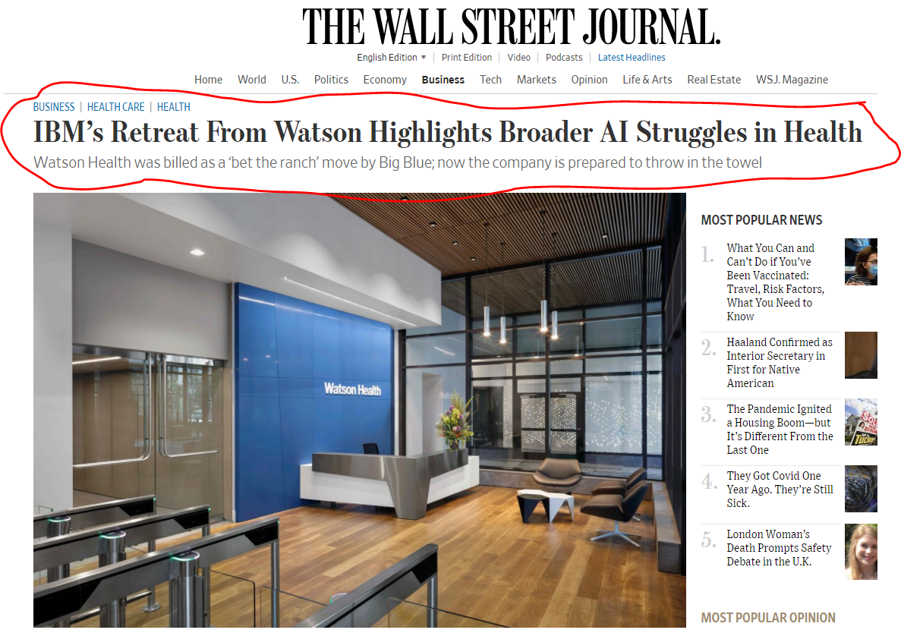

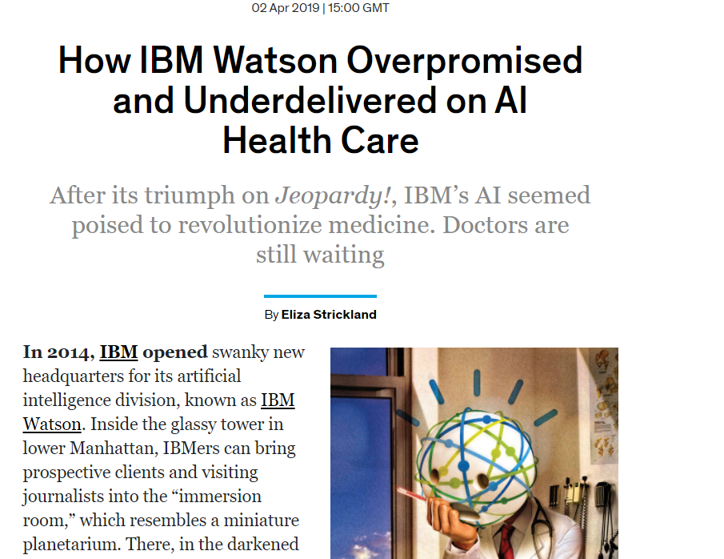
Reality

Slide 5
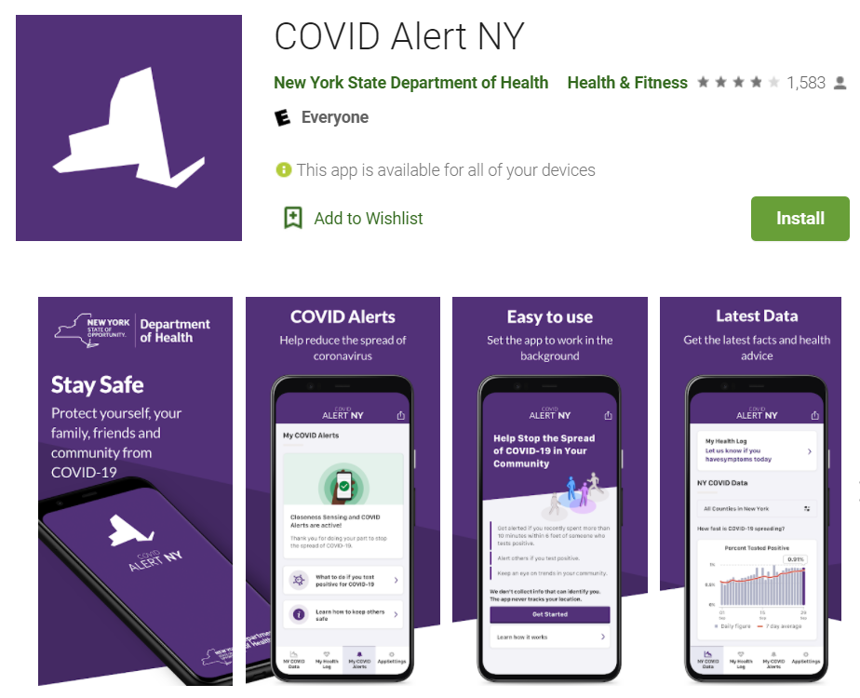
Contact Tracing

Slide 6
